Slide 1


SQL Part 2

Slide 2
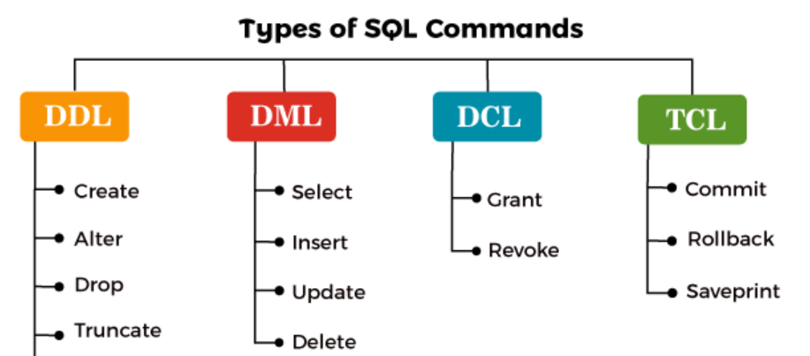

Slide 3
Constraints in databases are rules or conditions that must be met for data to be
inserted, updated, or deleted in a database table. They are used to enforce the
integrity of the data stored in a database and to prevent data from becoming
inconsistent or corrupted.
1. NOT NULL
2. UNIQUE(combo)
-> Another way of creating constraint
3. PRIMARY KEY
4. AUTO INCREMENT
5. CHECK
6. DEFAULT
7. FOREIGN KEY

Slide 4
Select
Select columns
Select specific columns
Select distinct column values as "all categories" from dataset.
Filtering with WHERE
Basic condition
Multiple conditions with AND
Multiple conditions with OR
Negation with NOT
BETWEEN for range filtering
IN for specific values

Slide 5
Column Functions
Count total rows
Sum of all values in a particular column
Average value of column
Maximum and minimum value of a column
Round off
Increase salary by 10%
String Functions: Convert names to uppercase
Get the length of each name

Slide 6
Sorting with ORDER BY
Ascending order
Descending order
Multiple sorting columns
Limiting Results with LIMIT
Retrieve top 10 rows
Skip first 5 rows and fetch next 10
Grouping with GROUP BY
Group by department and count employees
Average salary by country

Slide 7
Filtering Groups with HAVING
Departments with more than 5 employees
Countries with an average salary above 80,000

Slide 8
Question
Sort employees by salary in ascending order.
Sort employees by salary in descending order.
Sort employees age in ascending order, and salary in descending order.
Retrieve the top 10 highest-paid employees.
Skip the first 5 rows and retrieve the next 10 rows. Find unique departments.
Count the number of employees in each department.
Find the average salary , average age of employees in each country. Find the total salary given to the departments. Find the average salary given to the departments in every country.

Slide 9
Find people where salary >90000 Find departments that have more than 10 employees.
Find countries with an average salary above 80,000. Find departments with more than 9 employees and an average age<40 Identify countries with at least 3 departments where the average salary exceeds 80,000 Most expensive department in a particular country Second most expensive department List department with at least two employees having same salary.
Round the salaries of employees to the nearest thousand.
Increase all employees' salaries by 10%.
Convert all employee names to uppercase.
Get the length of each employee's name.

Slide 10

Thank you

